Slide 1
Schedulers
Schedulers are special system software which handle process scheduling in various ways. Their main task is to select the jobs to be submitted into the system and to decide which process to run. Schedulers are of three types −
Long-Term Scheduler
Short-Term Scheduler
Medium-Term Scheduler

Slide 2
Long Term Scheduler
It is also called a job scheduler. A long-term scheduler determines which programs are admitted to the system for processing. It selects processes from the queue and loads them into memory for execution. Process loads into the memory for CPU scheduling.
The primary objective of the job scheduler is to provide a balanced mix of jobs, such as I/O bound and processor bound. It also controls the degree of multiprogramming. If the degree of multiprogramming is stable, then the average rate of process creation must be equal to the average departure rate of processes leaving the system.
On some systems, the long-term scheduler may not be available or minimal. Time-sharing operating systems have no long term scheduler. When a process changes the state from new to ready, then there is use of long-term scheduler.

Slide 3
Short Term Scheduler
It is also called as CPU scheduler. Its main objective is to increase system performance in accordance with the chosen set of criteria. It is the change of ready state to running state of the process. CPU scheduler selects a process among the processes that are ready to execute and allocates CPU to one of them.
Short-term schedulers, also known as dispatchers, make the decision of which process to execute next. Short-term schedulers are faster than long-term schedulers.

Slide 4
Medium Term Scheduler
Medium-term scheduling is a part of swapping. It removes the processes from the memory. It reduces the degree of multiprogramming. The medium-term scheduler is in-charge of handling the swapped out-processes.
A running process may become suspended if it makes an I/O request. A suspended processes cannot make any progress towards completion. In this condition, to remove the process from memory and make space for other processes, the suspended process is moved to the secondary storage. This process is called swapping, and the process is said to be swapped out or rolled out. Swapping may be necessary to improve the process mix.

Slide 5
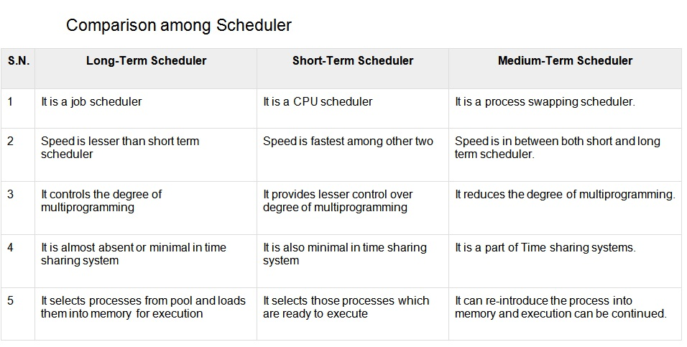

Slide 6
Context Switch
A context switch is the mechanism to store and restore the state or context of a CPU in Process Control block so that a process execution can be resumed from the same point at a later time. Using this technique, a context switcher enables multiple processes to share a single CPU. Context switching is an essential part of a multitasking operating system features.
When the scheduler switches the CPU from executing one process to execute another, the state from the current running process is stored into the process control block. After this, the state for the process to run next is loaded from its own PCB and used to set the PC, registers, etc. At that point, the second process can start executing.

Slide 7
Context Switch
Context switches are computationally intensive since register and memory state must be saved and restored. To avoid the amount of context switching time, some hardware systems employ two or more sets of processor registers. When the process is switched, the following information is stored for later use.
Program Counter
Scheduling information
Base and limit register value
Currently used register
Changed State
I/O State information
Accounting information

Slide 8
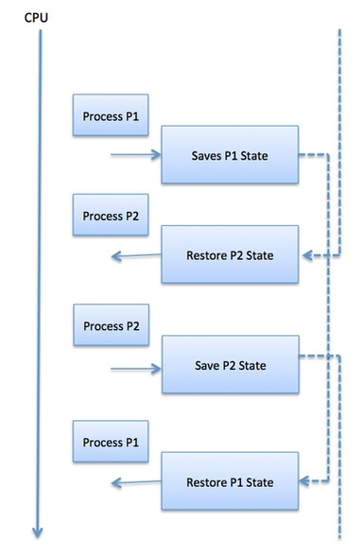
Context Switch

Slide 9
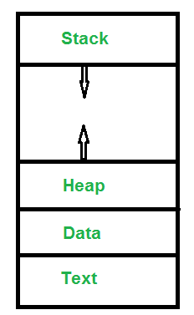
Operations on Processes
Process: A process is an activity of executing a program. Basically, it is a program under execution. Every process needs certain resources to complete its task.

Slide 10
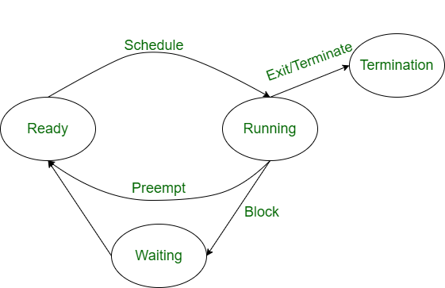
Operations on Processes
Operation on a Process: The execution of a process is a complex activity. It involves various operations. Following are the operations that are performed while execution of a process:

Slide 11
Operations on Processes
1. Creation:
2. Scheduling/Dispatching:
3. Blocking:
4. Preemption:
5. Termination:

Slide 12
Operations on Processes
1. Creation: This the initial step of process execution activity. Process creation means the construction of a new process for the execution. This might be performed by system, user or old process itself. There are several events that leads to the process creation. Some of the such events are following:
When we start the computer, system creates several background processes.
A user may request to create a new process.
A process can create a new process itself while executing.
Batch system takes initiation of a batch job.

Slide 13
Operations on Processes
2. Scheduling/Dispatching: The event or activity in which the state of the process is changed from ready to running. It means the operating system puts the process from ready state into the running state. Dispatching is done by operating system when the resources are free or the process has higher priority than the ongoing process. There are various other cases in which the process in running state is preempted and process in ready state is dispatched by the operating system.

Slide 14
Operations on Processes
3. Blocking: When a process invokes an input-output system call that blocks the process and operating system put in block mode. Block mode is basically a mode where process waits for input-output. Hence on the demand of process itself, operating system blocks the process and dispatches another process to the processor. Hence, in process blocking operation, the operating system puts the process in ‘waiting’ state.

Slide 15
4. Preemption: When a timeout occurs that means the process hadn’t been terminated in the allotted time interval and next process is ready to execute, then the operating system preempts the process. This operation is only valid where CPU scheduling supports preemption. Basically this happens in priority scheduling where on the incoming of high priority process the ongoing process is preempted. Hence, in process preemption operation, the operating system puts the process in ‘ready’ state.

Slide 16
Operations on Processes
5. Termination: Process termination is the activity of ending the process. In other words, process termination is the relaxation of computer resources taken by the process for the execution. Like creation, in termination also there may be several events that may lead to the process termination. Some of them are:
Process completes its execution fully and it indicates to the OS that it has finished.
Operating system itself terminates the process due to service errors.
There may be problem in hardware that terminates the process.
One process can be terminated by another process.

Slide 17
Cooperating Process
Cooperating processes are those that can affect or are affected by other processes running on the system. Cooperating processes may share data with each other.
Reasons for needing cooperating processes
There may be many reasons for the requirement of cooperating processes. Some of these are given as follows −
Modularity: Modularity involves dividing complicated tasks into smaller subtasks. These subtasks can completed by different cooperating processes. This leads to faster and more efficient completion of the required tasks.

Slide 18
Information Sharing: Sharing of information between multiple processes can be accomplished using cooperating processes. This may include access to the same files. A mechanism is required so that the processes can access the files in parallel to each other.
Convenience: There are many tasks that a user needs to do such as compiling, printing, editing etc. It is convenient if these tasks can be managed by cooperating processes.
Computation Speedup: Subtasks of a single task can be performed parallely using cooperating processes. This increases the computation speedup as the task can be executed faster. However, this is only possible if the system has multiple processing elements.

Slide 19
Methods of Cooperation:
Cooperating processes can coordinate with each other using shared data or messages. Details about these are given as follows −
Cooperation by SharingThe cooperating processes can cooperate with each other using shared data such as memory, variables, files, databases etc. Critical section is used to provide data integrity and writing is mutually exclusive to prevent inconsistent data.

Slide 20
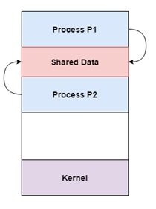
A diagram that demonstrates cooperation by sharing is given as follows −
In the above diagram, Process P1 and P2 can cooperate with each other using shared data such as memory, variables, files, databases etc.

Slide 21
Cooperation by Communication:
The cooperating processes can cooperate with each other using messages. This may lead to deadlock if each process is waiting for a message from the other to perform a operation. Starvation is also possible if a process never receives a message.

Slide 22
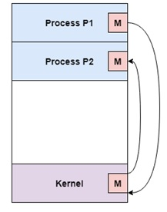
A diagram that demonstrates cooperation by communication is given as follows −
In the above diagram, Process P1 and P2 can cooperate with each other using messages to communicate.

